Slide 1
Chapter 11.01: Introduction to Fourier Series
Lecture # 1
by
Dr. Md. Rajibul Islam
CSE, UAP

Slide 2
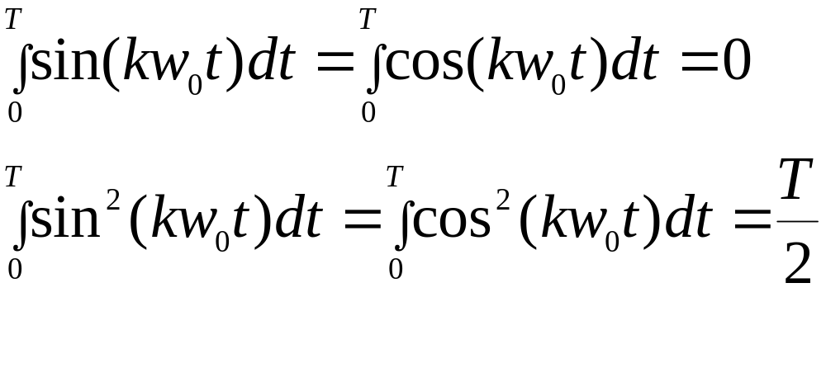
Background
The following relationships can be readily established
(1)
(2)
1

Slide 3
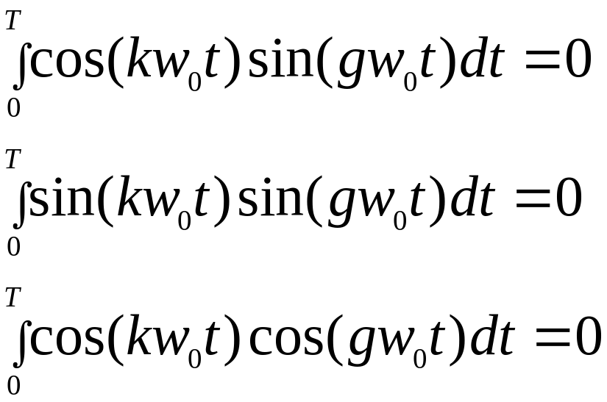
Background cont.
(3)
(4)
(5)

Slide 4
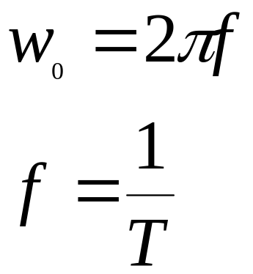


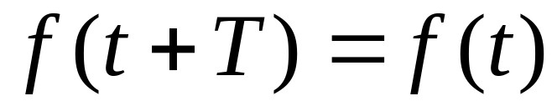
Background cont.
(6)
(7)
Where
and
represents the frequency
in (cycles/time)
and period (in seconds) respectively.
A periodic function with a period
should satisfy
the following equation:
(8)

Slide 5
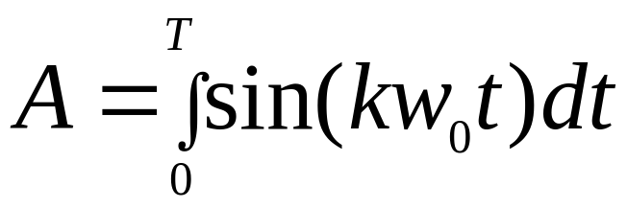
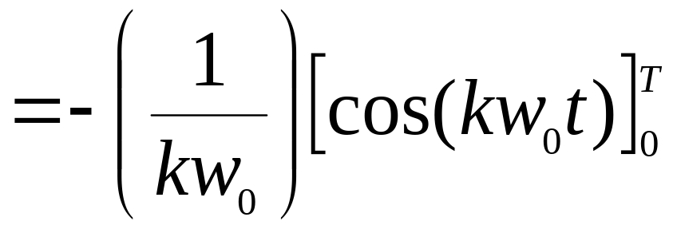
Background cont.
Example 1
Let
(9)

Slide 6
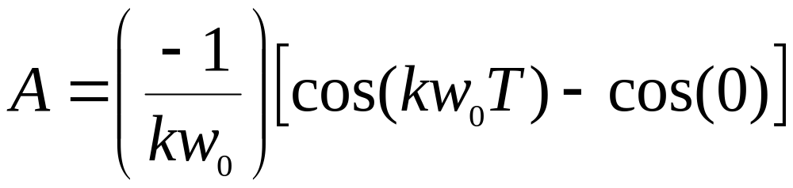
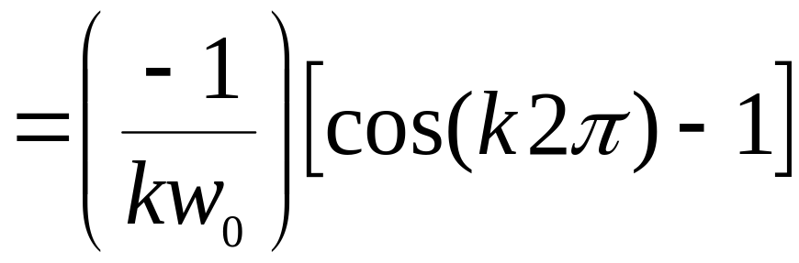

Background cont.
(10)

Slide 7
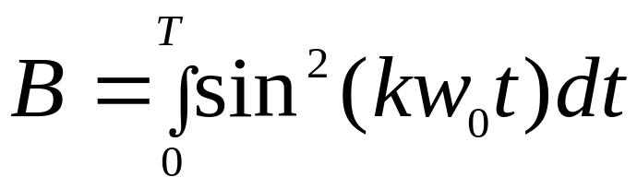
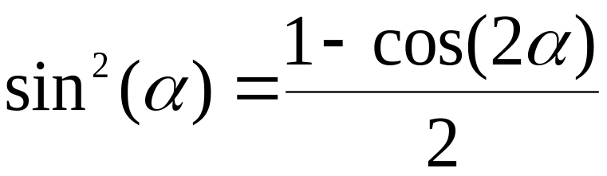
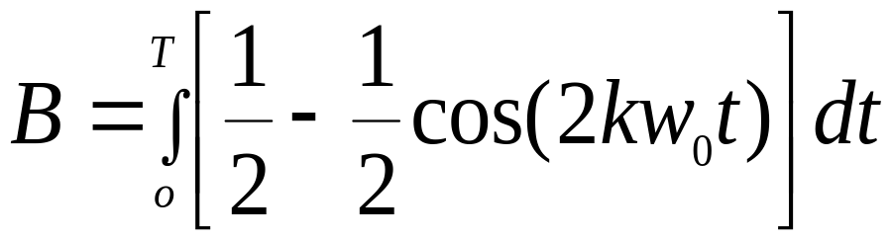
Background cont.
Example 2
Let
(11)
Recall
(12)
(13)

Slide 8
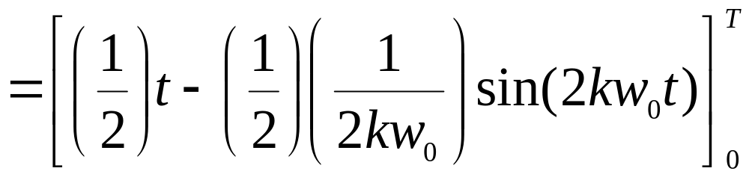
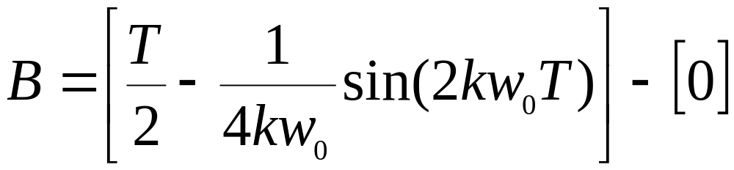
Background cont.
(14)

Slide 9
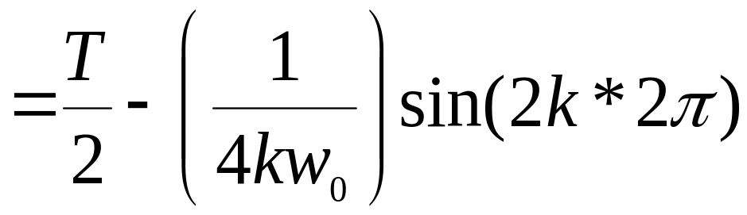
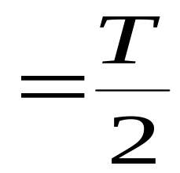
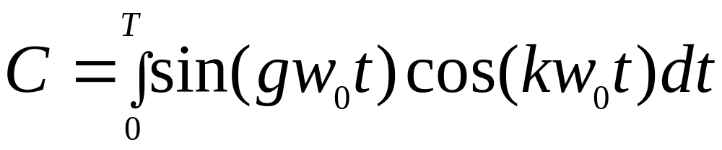
Background cont.
Example 3
Let
(15)

Slide 10
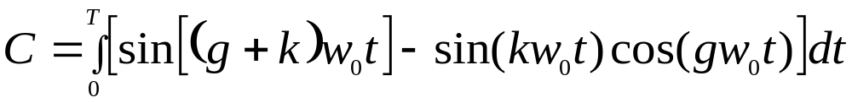
Background cont.
Recall that
(16)
(17)

Slide 11
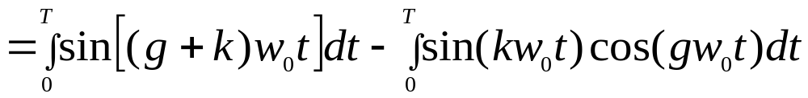
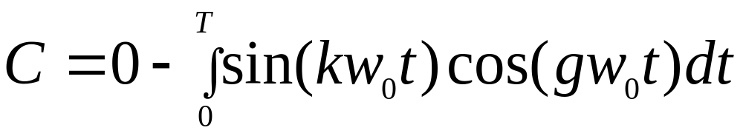
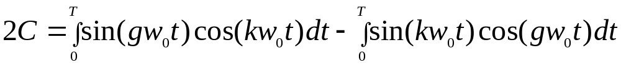
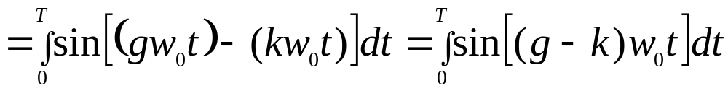
Background cont.
(18)
(19)
Adding Equations (15), (19),
(20)

Slide 12
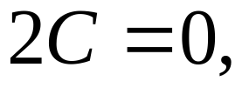
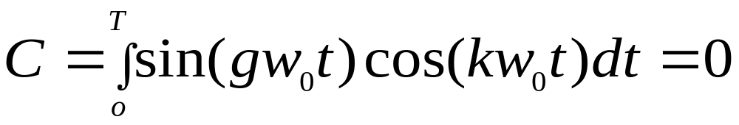
Background cont.
since the right side of the above equation is zero
Thus,
(21)

Slide 13
THE END

Slide 14
Acknowledgement
This instructional power point brought to you by
Numerical Methods for STEM undergraduate
http://numericalmethods.eng.usf.edu
Committed to bringing numerical methods to the undergraduate

